Slide 1

Winter 2020 Computer Programmer: FPS Inventory

Slide 2



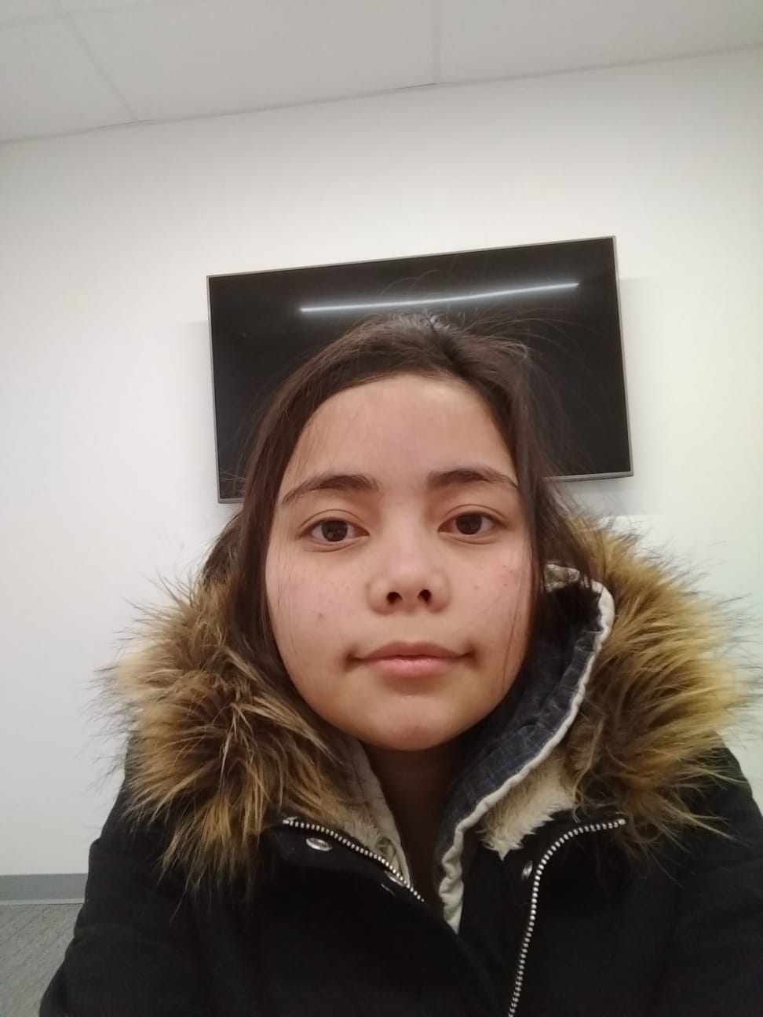
Mentored by: Sonam Devgan
Sandy MacAskill
Felipe Mafra
Dos Santos
Jemillee Prado

Slide 3
What does it do?
Find and add products quickly and easily
Find and add employees
Create incoming and outgoing orders with multiple products for each location
Reports generated to show complete individual store inventory and transactions with a specified date range
Bulk import inventory data
Keep customers happy and informed
Cut down on time waste at multiple locations

Slide 4
Featuring: SQL Server ASP.Net HTML5, CSS3, Javascript and Jquery

Slide 5
What does it do?
Access your inventory from any web capable device
Import existing Excel inventory
Search for the right item at the right location
Browse entire departments
Generate a weekly re-order list
Transfer stock between locations

Slide 6
Conclusion
All project documentation delivered
All project requirements completed
Delivered working software project

